Slide 1

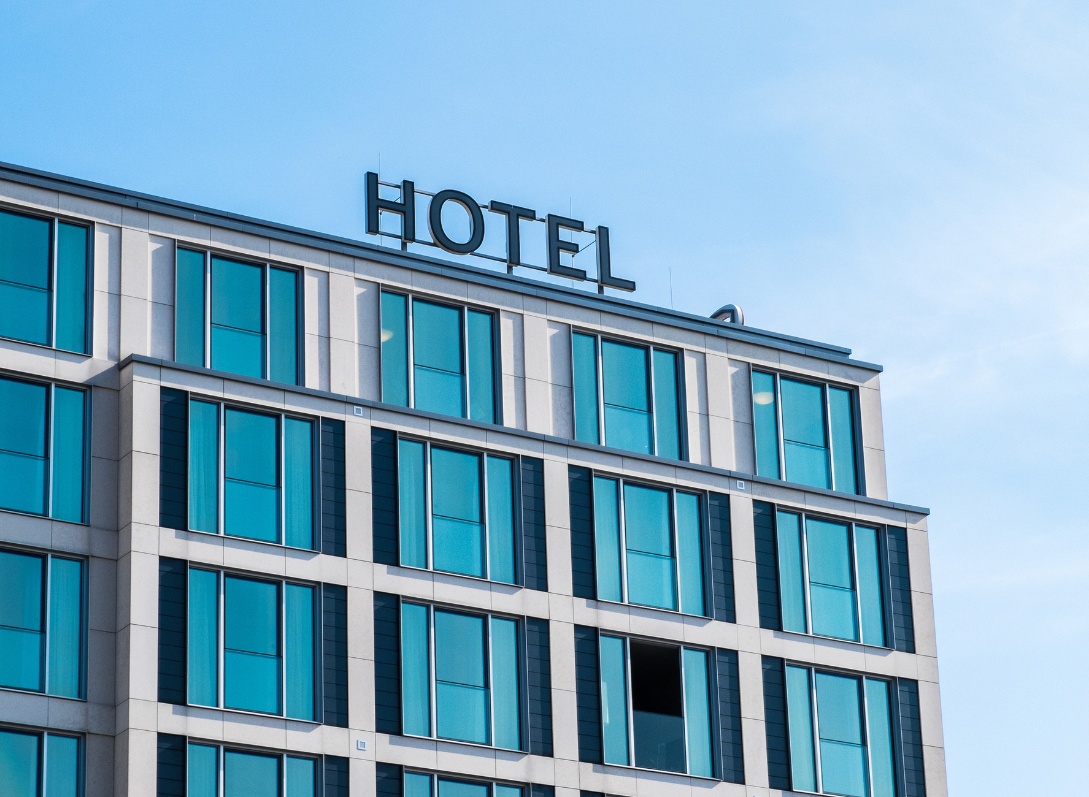

FINAL PROJECT PRESENTATION
HOTEL BOOKING DEMAND
GEDE SATYA DANANJAYA

Slide 2
Business Background & Objective
Data Preparation
Data analysis & exploration
Performance metrics
Modelling
Conclusion & Business Impact
Table Of Contents

Slide 3

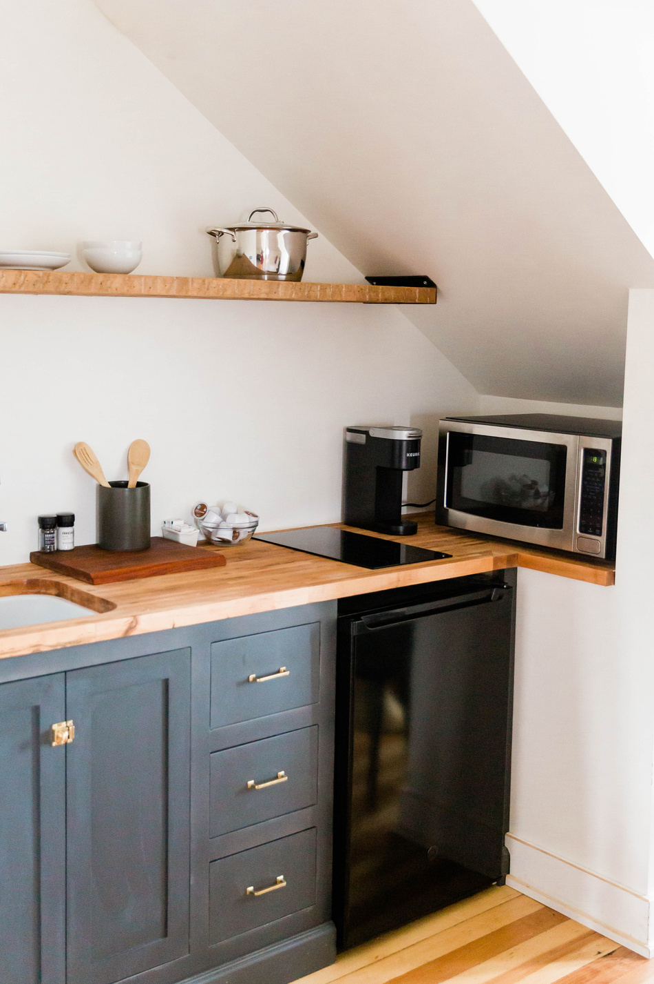
WHAT IS HOTEL CANCELATION?
Hotel cancellation means to cancel a reservation or booking for a hotel room. This can be done by either the guest who made the reservation or the hotel itself. It may be due to a policy, change in circumstances, or other reasons.

Slide 4
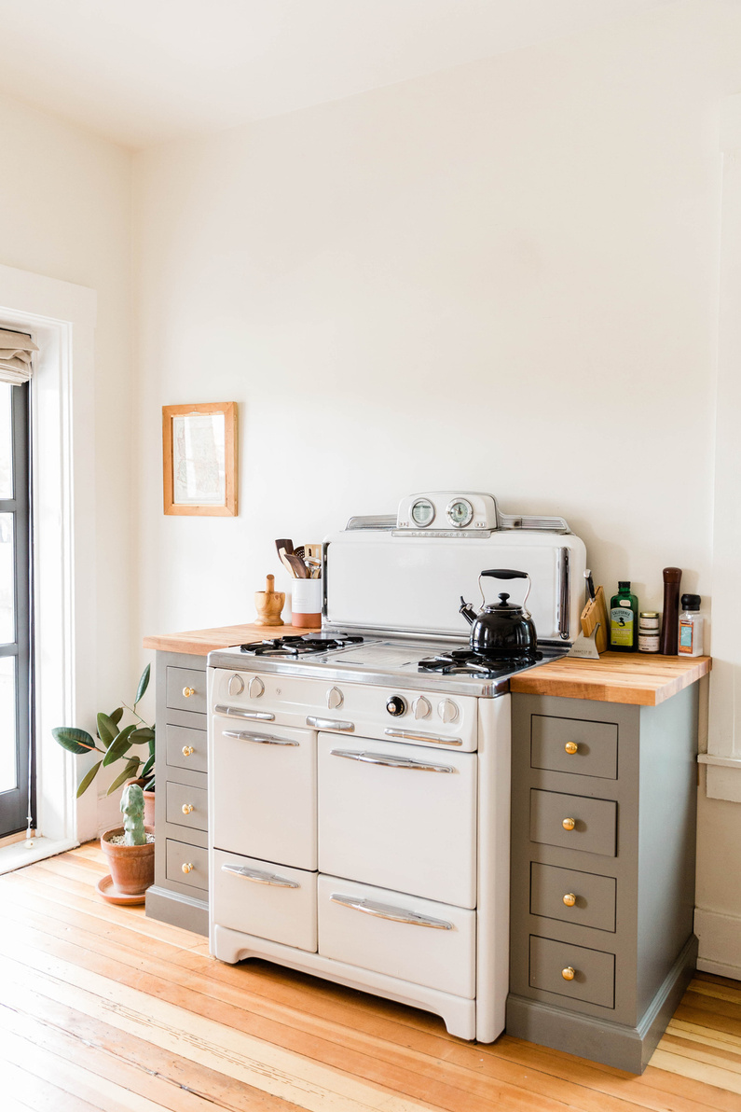
HOTEL CANCELLATION RATES
In December 2019, Fornova surveyed over 200,000 hotels worldwide to learn about their cancellation policies. They found that 38% of hotels offered free cancellation, and 62% had a no-refund policy. In July 2020, they repeated the survey and found that 58% of hotels now offer free cancellations, while 42% still don't offer refunds. The pandemic caused this shift in the industry.

Slide 5
Context & Objective
Context
In today's society, hotel booking has become an essential service for many people. With the rise of technology and online booking platforms, it has become easier than ever to book a hotel room from anywhere in the world. However, the demand for hotel bookings can be influenced by various factors, such as economic conditions, seasonal trends, and changes in travel behavior.
Objective
To optimize hotel bookings and lower cancelation rates

Slide 6
Data Preparation
HOTEL BOOKING DEMAND

Slide 7
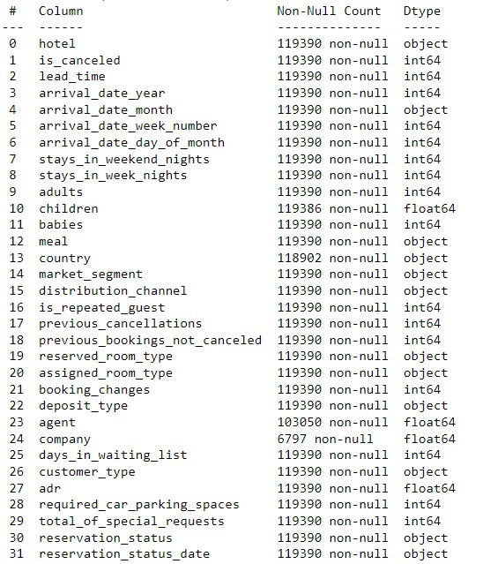
DATA IMPORTING AND CLEANING
IMPORTED DATA CONSIST OF 119210 ROWS AND 32 COLUMNS HOTEL.CSV

Slide 8
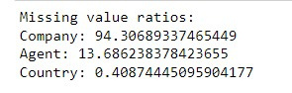
REPLACING MISSING VALUES
As we can see here, there are a lot of missing value in this column, so we will fix them.
1. agent: If no agency is given,
booking was most likely made
without one.
2. company: If none given, it was
most likely private.

Slide 9
DATA ANALYSIS AND EXPLORATION
HOTEL BOOKING DEMAND

Slide 10
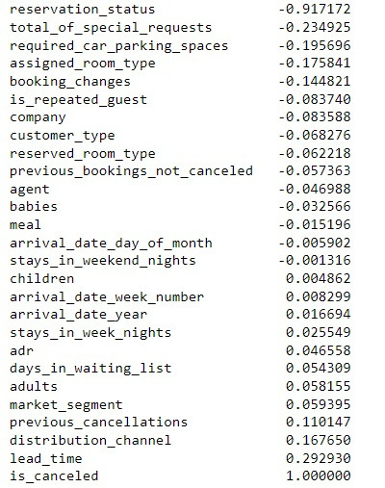
DATA ANALYSIS AND EXPLORATION
We already have function to determine corelation with df.coor. By default, df.corr() uses Pearson correlation coefficient, which measures the linear relationship between numerical variables.

Slide 11
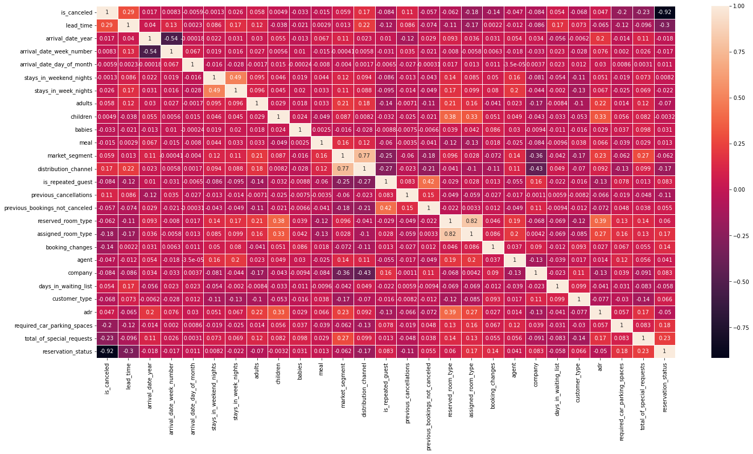
Heatmap Corelation

Slide 12
DATA ANALYSIS AND EXPLORATION
The feature that most impacts cancellation prediction is reservation status. We could remove this column to see if other features have a significant impact on cancellation prediction.
We should remove the columns arrival date week number, stays in weekend night, and arrival date day of month since they have low importance in predicting cancellations.
In the multiple correlation heatmap, we will remove distribution channel and assigned room type because they are highly correlated with market segment, and reserved room type to reduce the risk of overfitting the model.

Slide 13
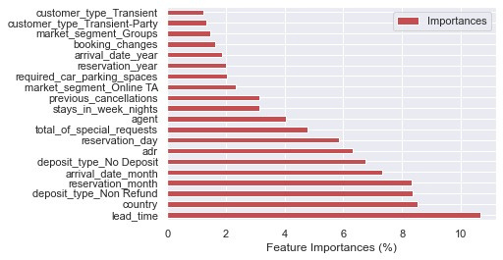
DATA ANALYSIS AND EXPLORATION
Feature Importance

Slide 14
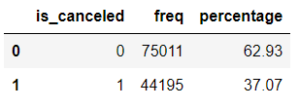
DATA ANALYSIS AND EXPLORATION
Cancellation Rate and Feature Importance
The cancellation rate for the dataset is 37.07%.
To identify the features that have the greatest impact on cancellations, we trained a model and calculated the feature importance scores. The top five features, in order of importance, are:
lead time
country
reservation month
deposit type
arrival date month
We can see that the feature "lead time" has the greatest impact on cancellations, followed by "country " and "reservation month". These features can help us identify customers who are at a higher risk of cancelling, and take proactive measures to prevent cancellations.

Slide 15
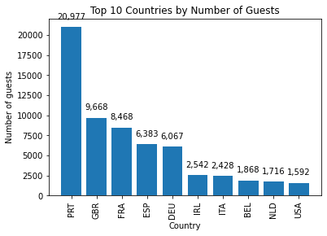

DATA ANALYSIS AND EXPLORATION
Where does the guest come from?
The top 5 countries that visited our hotels are Portugal, the UK, France, Spain, and Germany, according to the pie chart. This means that most of our guests come from these countries in Europe.

Slide 16
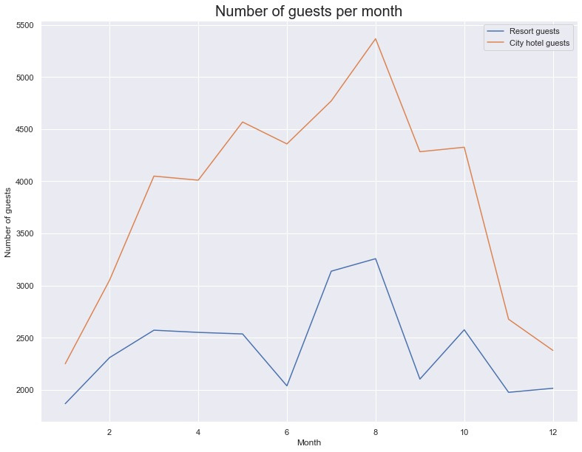

DATA ANALYSIS AND EXPLORATION
Number of guests per month
Based on the table, we can see that the busiest months for customers are August, July, May, October, April, June, and September. These months fall in the middle of the year and coincide with the summer season in Europe, when many people take holidays.

Slide 17
SUGGESTION
Offer attractive packages and discounts: Offer special packages and deals to guests during the low season to incentivize them to travel.
Promote the destination: Highlight the unique qualities of the destination, such as cultural events, outdoor activities, or local cuisine, to entice guests to visit.

Slide 18
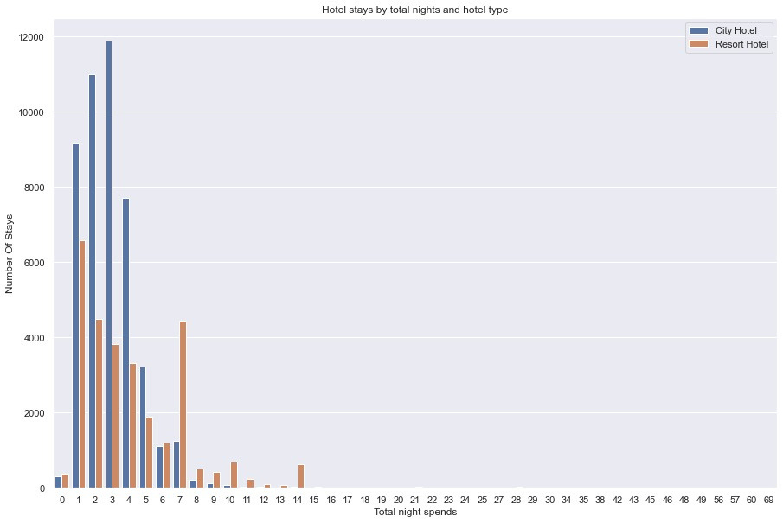
DATA ANALYSIS AND EXPLORATION
Total night spends by guests
In this bar plot we can see that most of the customers use city hotels compared to resort hotels and the average customer books hotels for a period of 1-14 days with peak bookings for resort hotels for 1 day and city hotels for 3 days.

Slide 19
SUGGESTION
Offer special deals to guests who book a longer stay to make it more attractive for them to stay longer.
Improve the guest experience by upgrading amenities, adding new services, or providing personalized service. This can lead to guests coming back again and again.

Slide 20
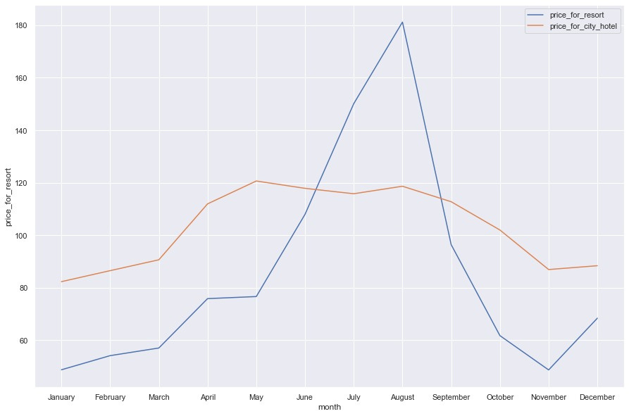
DATA ANALYSIS AND EXPLORATION
Price per month
The graph shows that the price per month increased in January and kept rising until May. There was a big increase from June to September, and then it started to decrease from October to November. The price went up again from November to December.

Slide 21
SUGGESTION
Here are some pricing strategies to consider during peak season:
Dynamic Pricing: Adjust prices based on real-time demand to maximize revenue.
Price Discrimination: Charge different prices to different customers based on factors such as booking lead time, room type, or length of stay.

Slide 22
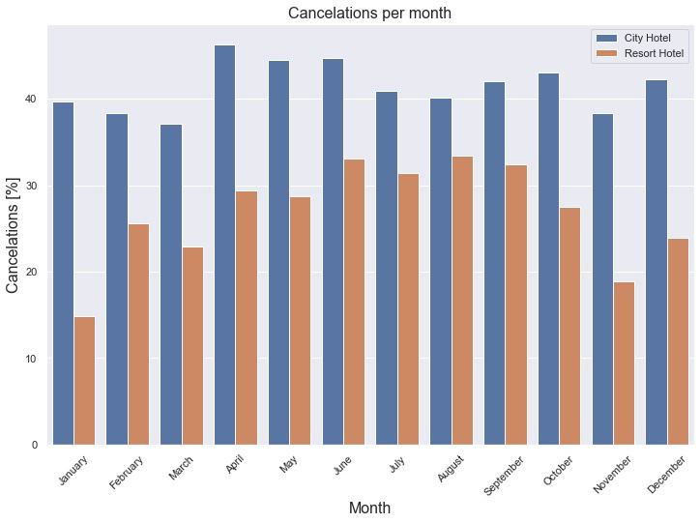
DATA ANALYSIS AND EXPLORATION
Cancelation per month
Most cancellations occur at city hotels compared to resort hotels, city hotels have an average cancellation rate of up to 40% and resort hotels have a fluctuating cancellation rate, increasing in summer and decreasing in winter

Slide 23
SUGGESTION
To reduce the risk of cancellations, hotels can offer flexible cancellation policies. For example, they can allow cancellations up to a certain number of days before check-in. If a cancellation does occur, hotels can offer alternative solutions such as a voucher for a future stay, to encourage the guest to reschedule rather than cancel.

Slide 24
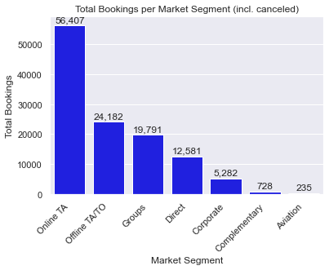
DATA ANALYSIS AND EXPLORATION
Bookings by market segment
From the following pie chart, online bookings are mostly made by Tour Agency, followed by offline bookings and group bookings.

Slide 25
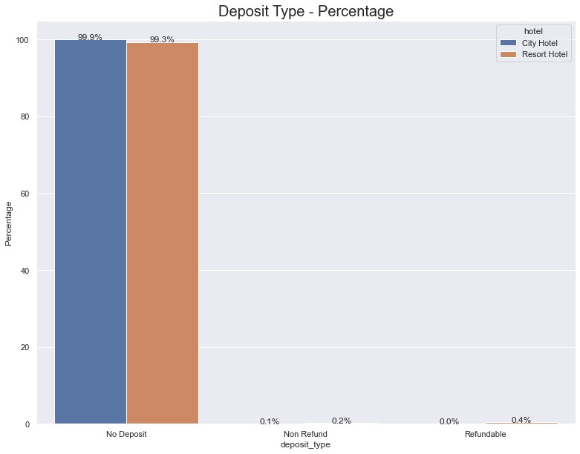
DATA ANALYSIS AND EXPLORATION
How do deposit types influence
cancelation?
In deposit type no one seems to cancel in the form of refundable type, this is pretty weird considering non-refund has a better choice. this might be happening because no deposit has a lower pricing than refundable option.

Slide 26
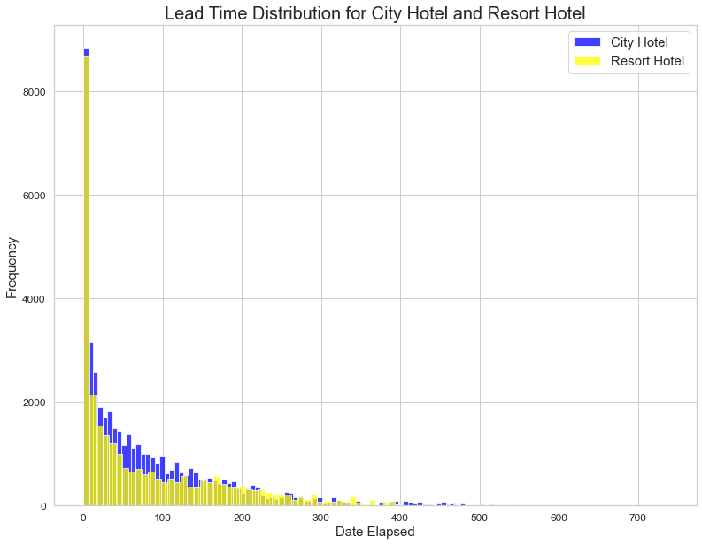
DATA ANALYSIS AND EXPLORATION
Lead Time distribution
Lead time refers to the time between booking a hotel and the check-in date. On average, people tend to book hotels on the same day or up to <500 days in advance.
City hotels are typically booked 80.7 days ahead of time, while resort hotels are booked 78.8 days ahead of time.
City hotel bookings usually happen around 50 days before the arrival date, but can range from 12 to 121 days in advance.

Slide 27
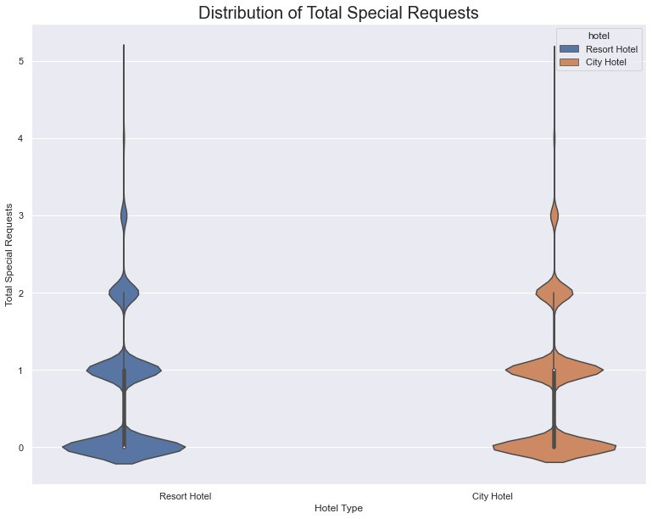
DATA ANALYSIS AND EXPLORATION
Total special request by guest
Most guest in a resort or city hotel has less than 3 requests. this can be beneficial to hotels because
1. Reduces staff workload
2. Improves financial performance

Slide 28
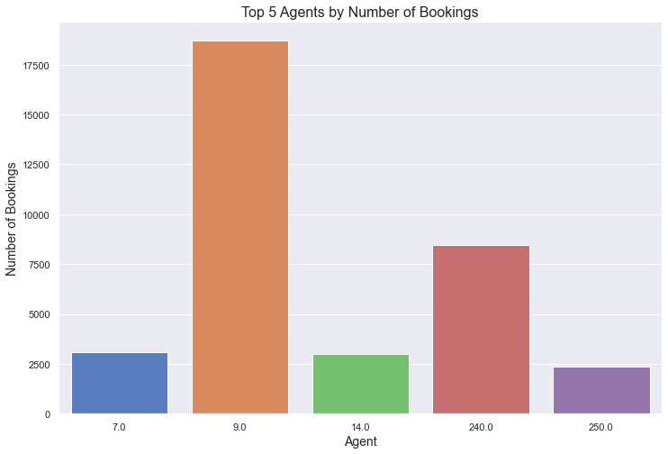
DATA ANALYSIS AND EXPLORATION
Proportion of bookings by agent:
Agent id 9 is the most successful in terms of bookings. To encourage this kind of success, hotels can offer bonuses or rewards to top-performing agents.

Slide 29
PERFORMANCE METRICS
HOTEL BOOKING DEMAND

Slide 30
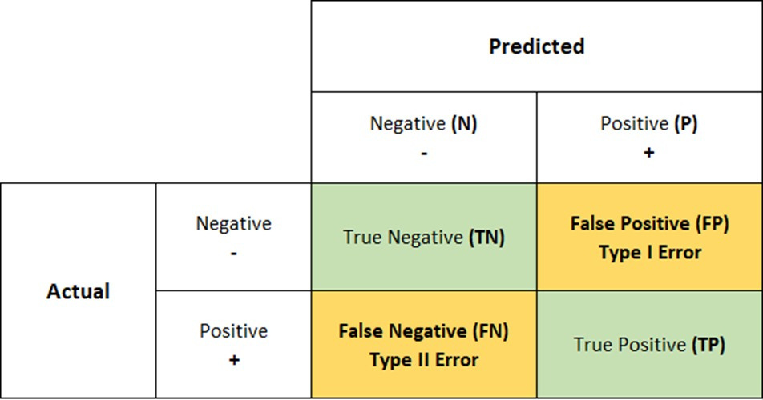
DEFINING PERFORMANCE METRICS

Slide 31
DEFINING PERFORMANCE METRICS
Which label is worse?
There are two types of mistakes a model can make: predicting someone cancels when they don't (false positive) or predicting someone won't cancel when they do (false negative).
Out of these two, a false negative is worse because it means the model failed to correctly identify that a guest canceled their reservation when they actually did.
The other two outcomes are positive: the model correctly identified either that the guest canceled (true positive) or that they didn't (true negative).

Slide 32
DEFINING PERFORMANCE METRICS
Recall, measures how well the model correctly identifies guests who canceled their reservations. It asks the question: "Out of all the guests who actually canceled, how many did the model identify correctly?"

Slide 33
MODELLING
HOTEL BOOKING DEMAND

Slide 34
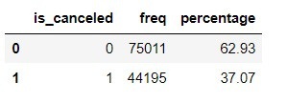
Modelling
There are fewer guests that cancel the booking
Our data is considered to have a mild imbalance according to google.

Slide 35
Modelling
The danger of imbalance:
Imbalanced data can cause problems for machine learning models, especially with minority classes. In our case, if the model is trained on imbalanced data, it may have trouble accurately predicting guest cancellations, which is not good. This can result in low accuracy, precision, and recall for the minority class.
To address these issues, it is important to either balancing the dataset or to use appropriate evaluation metrics and techniques, such as stratified cross-validation or class weighting.

Slide 36
Modelling
Options:
There are three options to deal with imbalanced data: random under-sampling, random over-sampling, and SMOTE.
Random under-sampling involves removing examples from the majority class.
Random over-sampling involves duplicating examples from the minority class.
SMOTE generates synthetic examples for the minority class instead of just duplicating them.

Slide 37

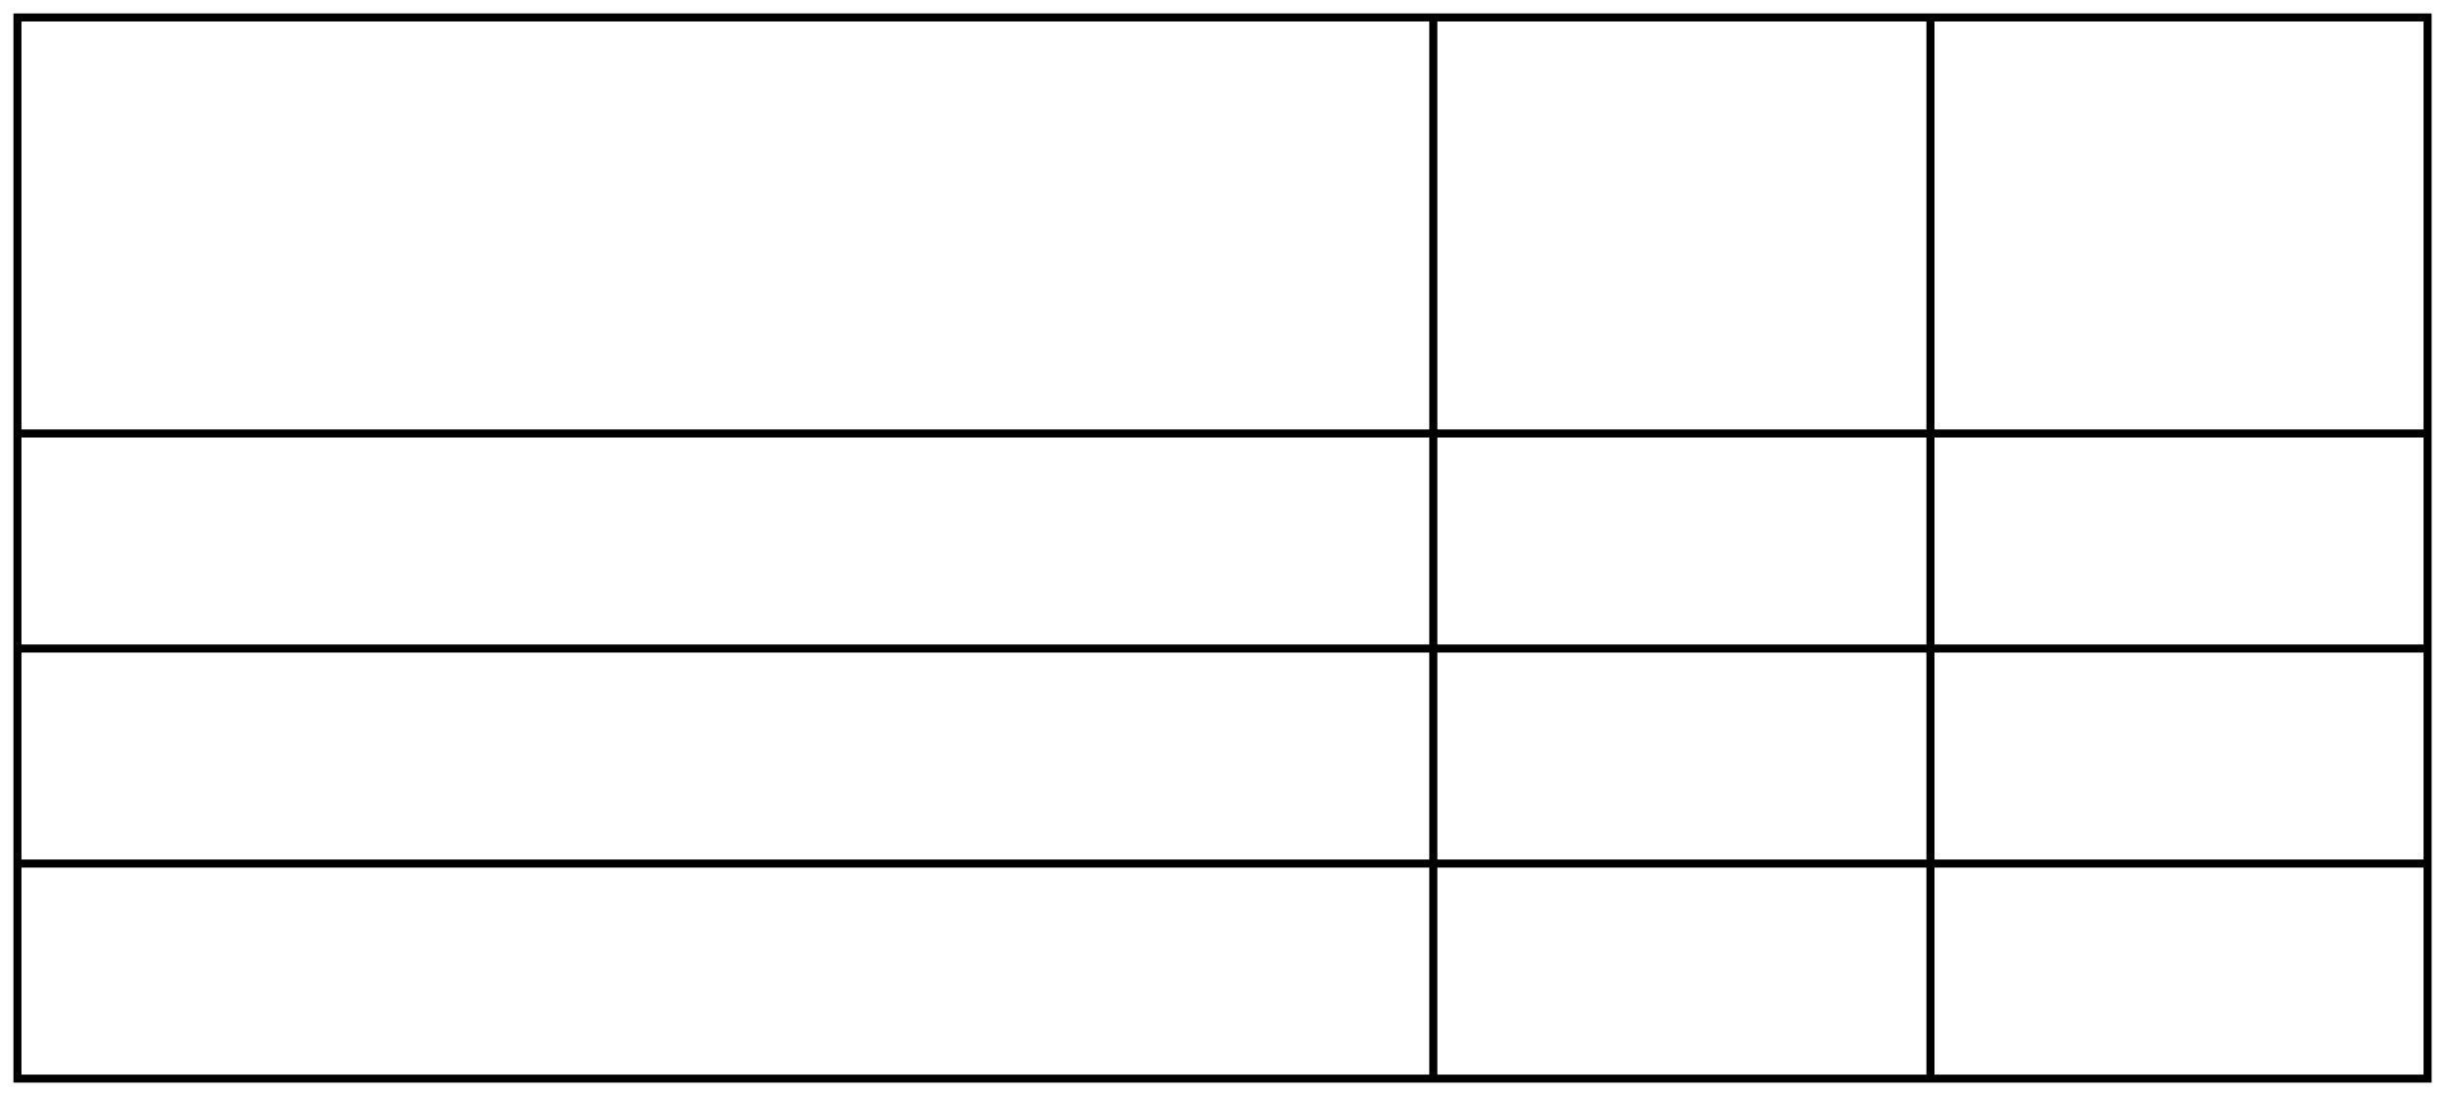
Modelling
First, we need to determine which algorithms we will use.
We check accuracy using a classifier of 3 algorithms, Random Forest, XGBoost, and KNN.
Accuracy (Imbalanced Data)
94.3% 94.2% 80.2%
Accuracy (Balanced Data)
94.7% 95.1% 82.9%
Model
Random Forest
XGBoost
K-Nearest Neighbor
With imbalanced data handling, we get more than 1% in accuracy in XGB and 2% in KNN

Slide 38
Modelling
We choose XGBoost for two main reasons: speed and scalability.
XGBoost is faster than Random Forest because it uses gradient boosting, which is a more efficient way to build decision trees.
It can handle large datasets and parallel processing, making it suitable for large-scale problems.

Slide 39
MODELLING
We need to do hyperparameter tuning before checking precision, recall, and F1-score because it helps to optimize the model's performance.
The goal of hyperparameter tuning is to find the best combination of hyperparameters to achieve the best results in terms of accuracy, precision, recall, F1 score, or other performance metrics.

Slide 40
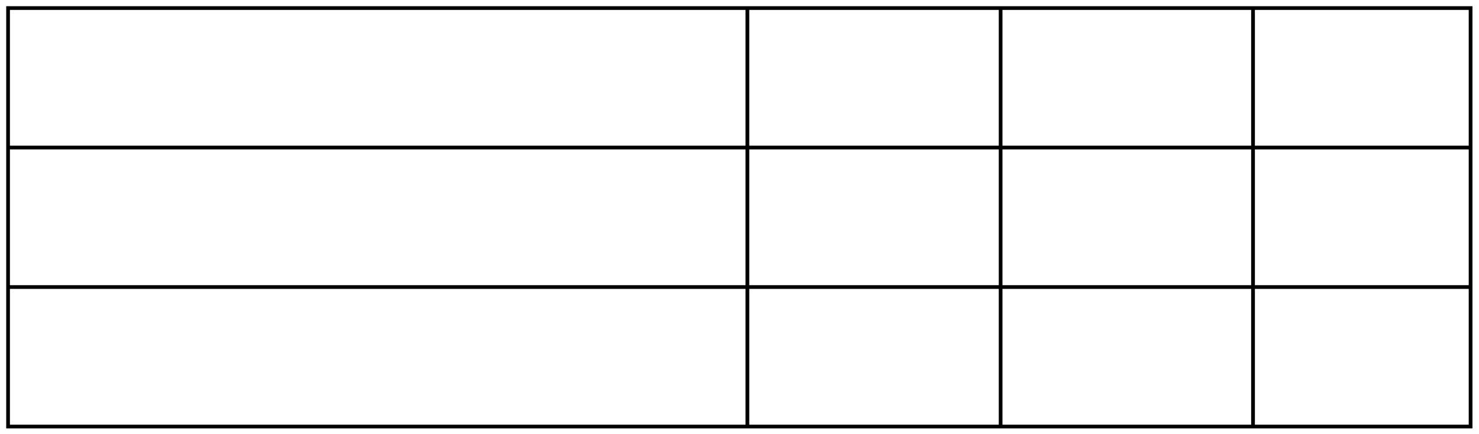
MODELLING
Model
Precision
Recall
F1-Score
Random Forest
89%
72%
79%
XGBoost
97%
91 %
94%

Slide 41
MODELLING
We tuned XGBoost to get 91% Recall which made it the best algorithm for our dataset. However, using CVgridsearch XGBoost without being randomized takes a long time. Our model is performing well with high precision and recall scores, and it is neither underfit nor overfit.

Slide 42
MODELLING
The classification model used in the analysis has an accuracy of 94% in predicting whether a booking will be cancelled or not.
It has a high recall of 0.97 for correctly identifying cancellations and a good precision of 0.92 for predicting cancellations.
The F1 score is 0.94, indicating a good balance between precision and recall.

Slide 43
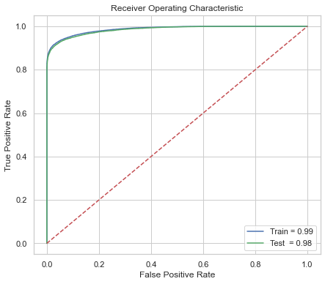
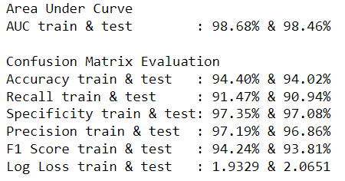
MODELLING
The model did really well on both the training and test sets. It had high scores for AUC and accuracy, meaning it was able to predict outcomes well.
It also did well in terms of recall, specificity, precision, and F1 scores, which show that it made correct predictions for both positive and negative cases.
Additionally, the log loss was low, meaning the model made few mistakes.

Slide 44
Potential impact on business
Our model can accurately predicting which customers are likely to cancel their bookings. It can identify 91% of customers who may cancel, which helps hotels take actions to prevent cancellations. Therefore, out of 1000 guests, the model would predict approximately 910, our model can help identify those 910 customers most likely to cancel. By offering these customers a discount or an upgraded room to keep their booking, the hotel can prevent cancellations and reduce their cancellation rate by approximately 1%.

Slide 45
CONCLUSION
This project provides useful information on how hotels can improve their sales and performance by analyzing customer behavior and hotel performance trends. By using this information, hotels can make better decisions about pricing, promotions, and other strategies to increase bookings and guest satisfaction, and stay competitive in the market.

Slide 46



Gede Satya Dananjaya
Thank you!
linkedin.com/in/satyadananjaya
github.com/dananjaya14
satyadananjaya@gmail.com

